Slide 1
Frontline
CLIQZ for Firefox
++

Slide 2


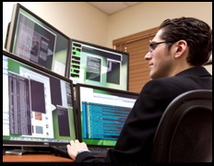

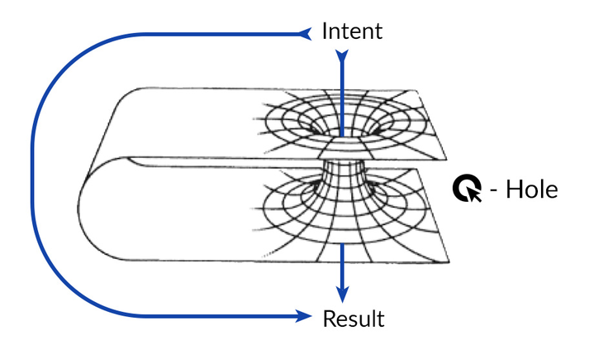

CLIQZ for Firefox
What some people think we do
What our parents think we do
What Google thinks we do
What our friends think we do
What we think we do
What we really do

Slide 3

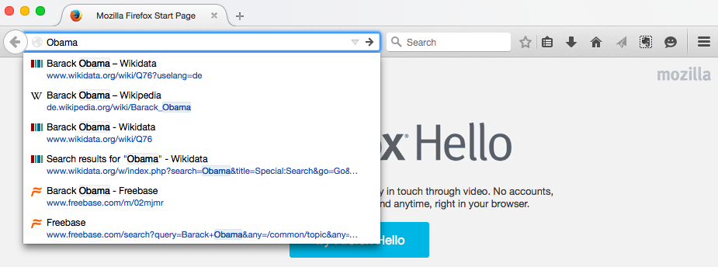

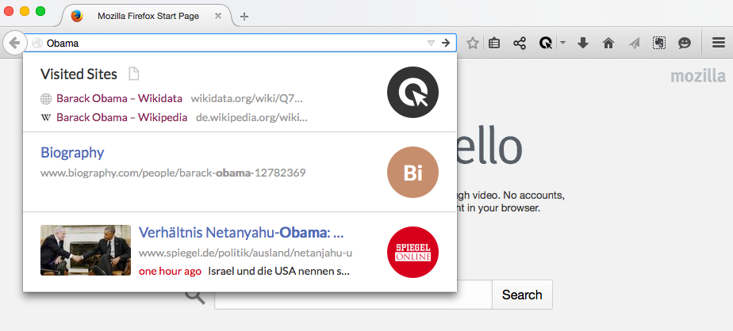
Normal
Firefox
With Cliqz

Slide 4




Static
resources
CDN
uCrawl
Write
Telemetry
S3
Querylog
Extension
Mixer
Big Machine
Rich Header

Slide 5
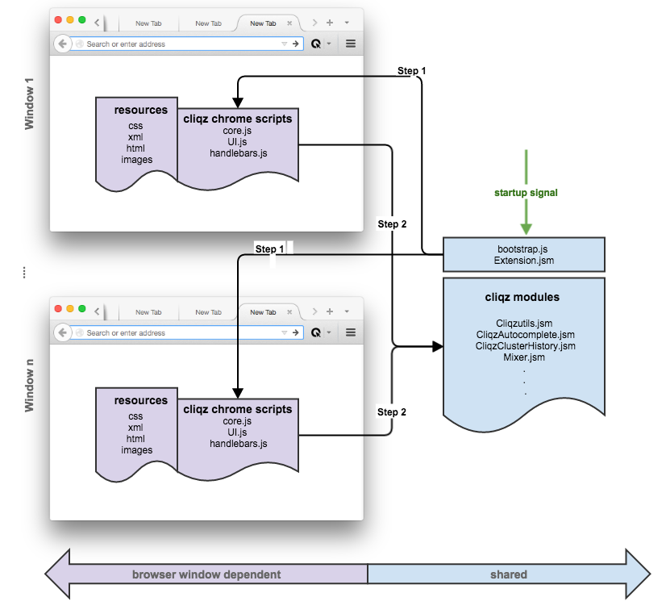
Architecture

Slide 6
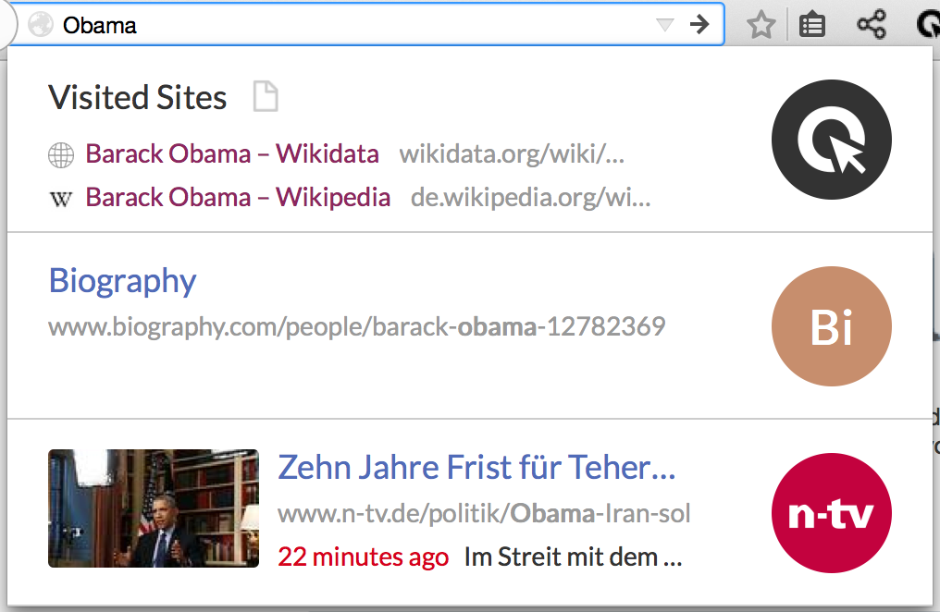
1,3,4
Log
CliqzClusterHistory.jsm
1
3
2
3
CliqzAutocomplete.jsm
Mixer
2
4

Slide 7
